Slide 1
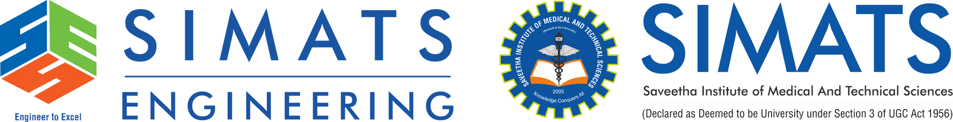
Design and Implementation of a Unified Project Management, Collaboration and Performance Monitoring System
DSA0107 – OBJECT ORIENTED PROGRAMMING WITH C++
PRESENTED BY
GUIDED BY
N.Akshaya (192425129)
G.Pranathi (192472237)
Samrakshini G (192511172)
Tharika S (192521140)
Mr. JEGADEESH K
Industrial Professional, Coimbatore

Slide 2


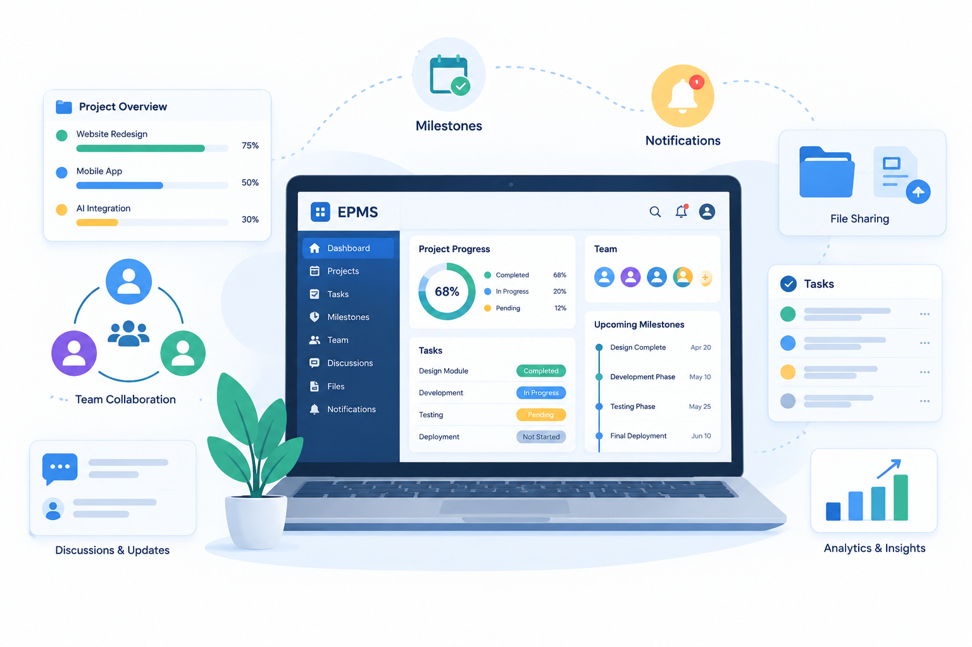
Abstract
Project Management & Collaboration System is a desktop application designed to simplify project planning, management, and collaboration within an organization.
The system provides a login interface and user registration facilities to support user access and create a centralized environment for managing project related activities.
The collaboration module brings project related comments, file sharing, and announcements together, helping team members exchange information and stay updated on project activities.
The dashboard and analytics features provide an overview of project progress and task status, helping users monitor performance and make better project management decisions.

Slide 3
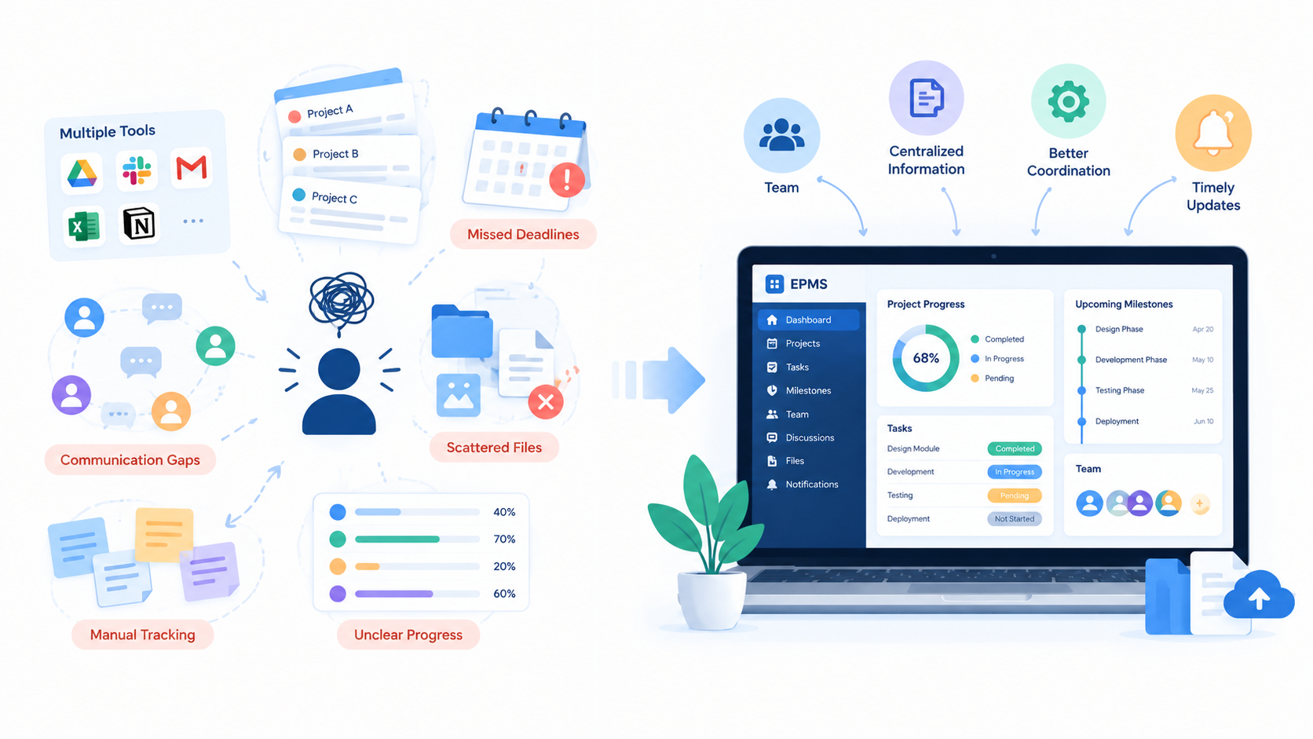
Problem Statement
Managing multiple projects using separate tools and manual methods makes it difficult to organize project information and maintain a clear view of ongoing activities.
Lack of centralized project information can make it challenging for team members and project managers to access updates, coordinate responsibilities, and stay informed.
Communication gaps between team members can cause misunderstandings, scattered discussions, and delays in sharing important project-related information and files.
Without a clear overview of project status and performance, project managers may find it difficult to identify pending tasks, monitor progress, and make timely decisions.

Slide 4
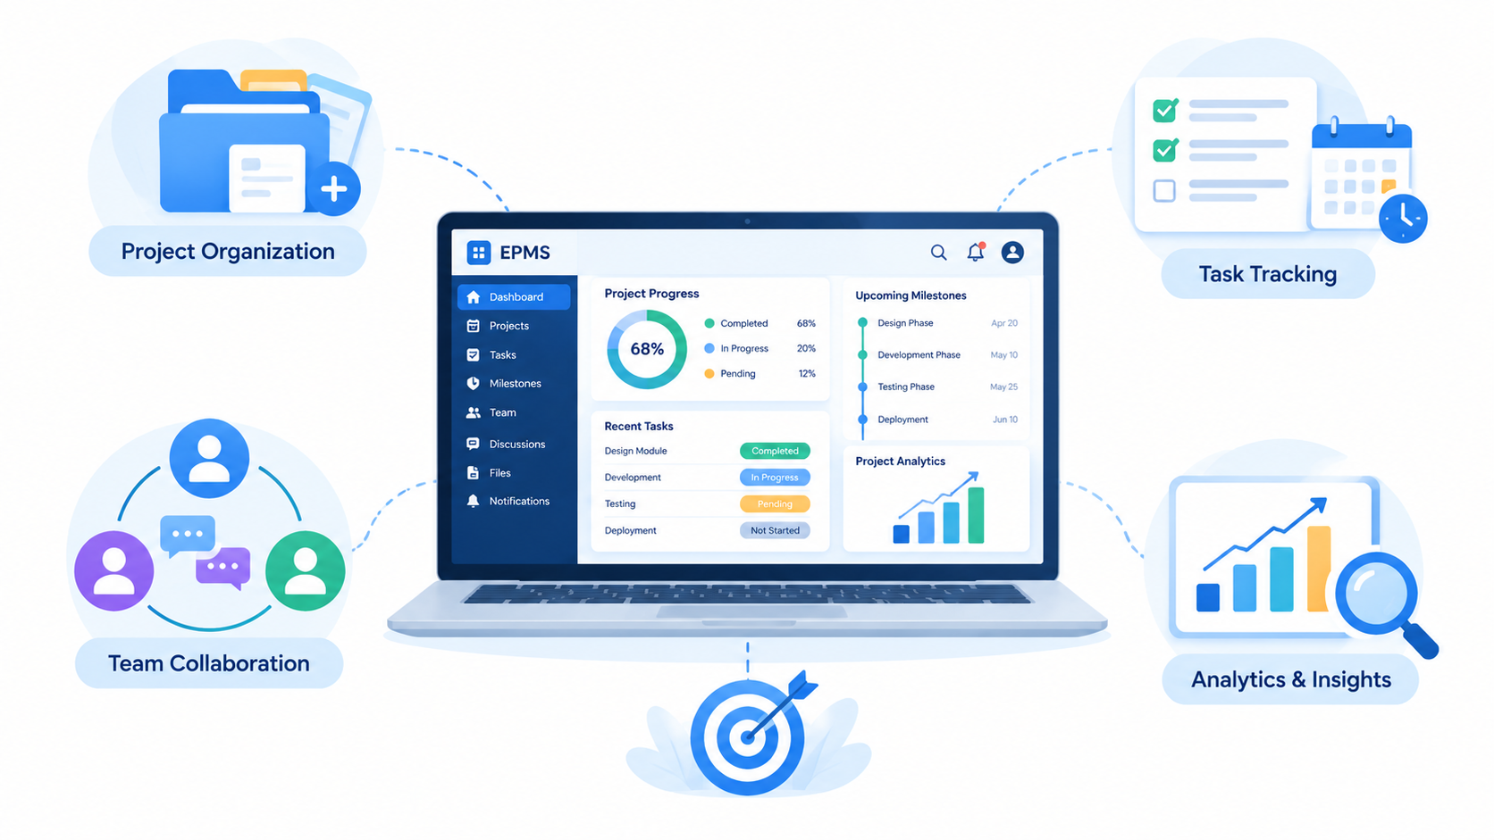
Objectives
To develop a centralized desktop application that simplifies project creation, project organization, and the management of project-related information in one place.
To provide efficient task assignment and milestone tracking facilities that help users monitor deadlines, identify pending activities, and follow project progress.
To improve team collaboration by providing features for project discussions, comments, announcements, and notifications to support effective information sharing.
To provide dashboards and analytics that present project status and performance information, helping users understand progress and make informed decisions.

Slide 5
Proposed System
PMS is a centralized desktop application developed using C++ and Qt to manage project activities through a single, user-friendly interface.
The system enables users to create and organize projects, assign tasks, and manage responsibilities efficiently.
Milestone tracking and task status monitoring help users follow deadlines, identify pending activities, and measure project progress.
Integrated collaboration features support project discussions, comments, announcements, and notifications to improve communication among team members..
The dashboard and analytics features present project progress, task status, and performance information to support better decision-making.

Slide 6
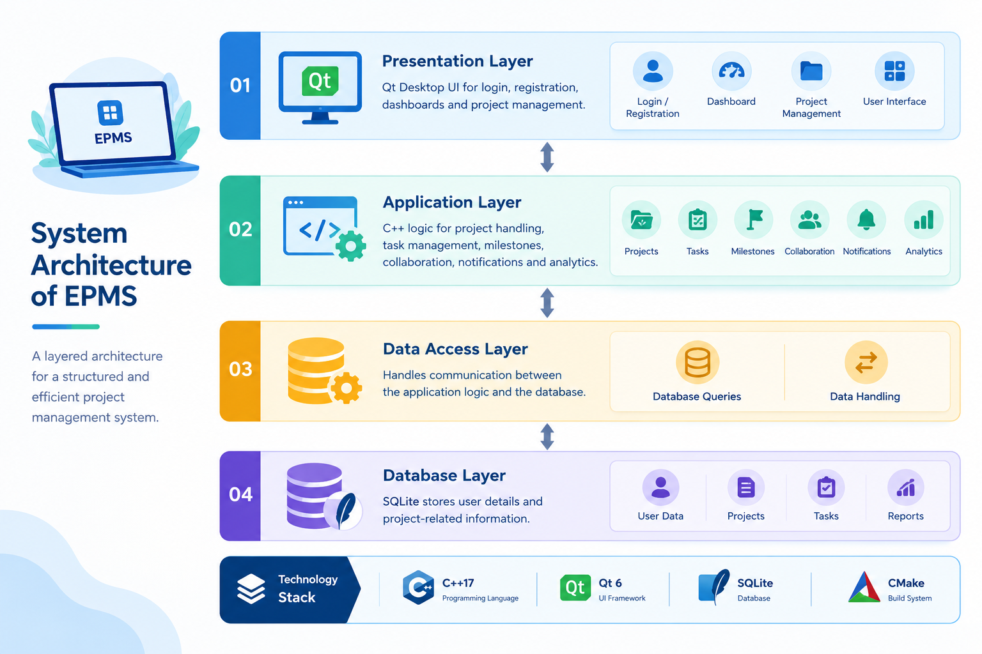
System Architecture Diagram

Slide 7
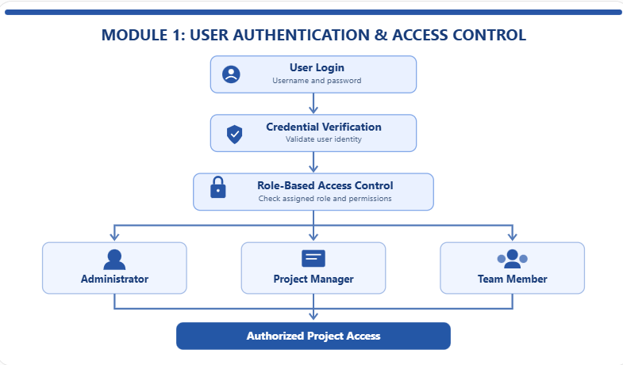
Module 1: User Authentication, Role Based Access Control & Project Management
Users can securely log in by entering valid credentials, ensuring that only authenticated individuals can access the application and its features.
Different access permissions are assigned to administrators, project managers, and team members according to their roles and responsibilities.
Administrators can create and manage user accounts, update user information, and control access privileges to maintain secure project operations.
Authorized users can create new projects, organize project details, and access relevant information based on their assigned permissions.

Slide 8
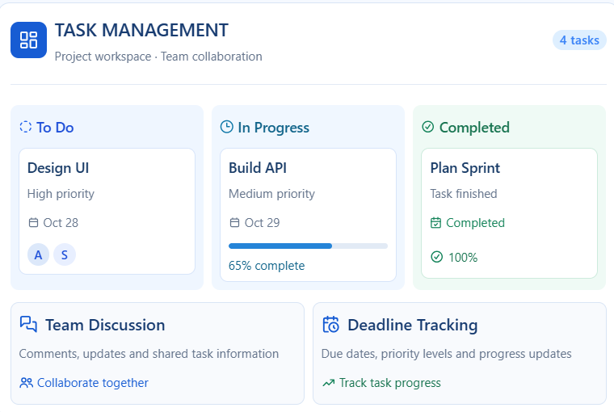
Module 2: Intelligent Task Management & Collaborative Work
Users can create, assign, and organize tasks within projects, ensuring that responsibilities are clearly distributed among team members.
Task priorities, deadlines, and status updates help teams monitor ongoing activities and complete work within the scheduled timeframe.
Team members can collaborate by sharing comments, discussing task-related issues, and exchanging important project information.
Task progress and assignment details can be tracked centrally, improving coordination, accountability, and overall team productivity

Slide 9
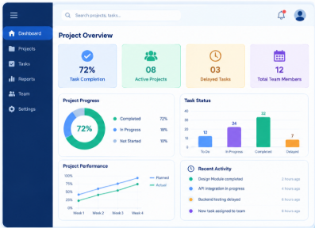
Module 3: Project Performance Analytics & Progress Monitoring
The system provides visual summaries of project performance, helping users understand the current status of ongoing projects.
Project progress is monitored through task completion rates, pending activities, and overall project status.
Analytical charts and graphical reports help project managers identify delays and evaluate team productivity.
Performance insights support better decision-making by highlighting project bottlenecks and areas that require improvement.

Slide 10
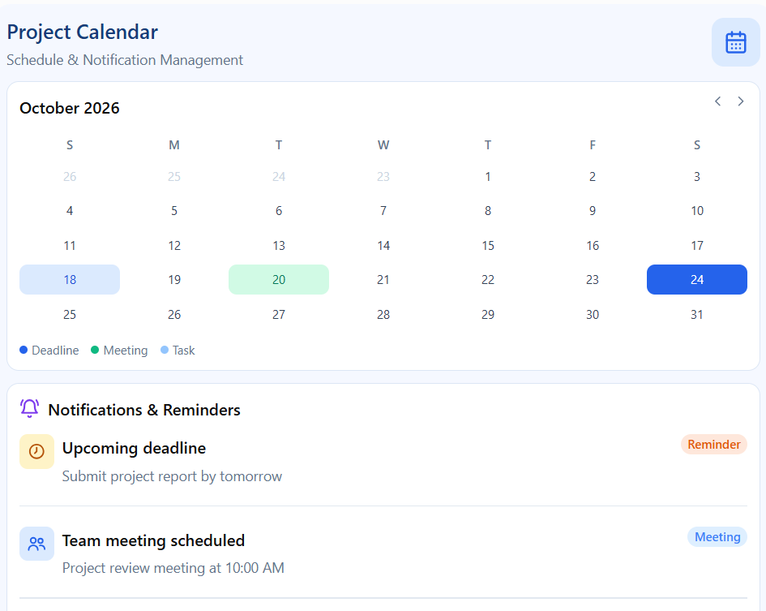
Module 4: Project Calendar & Notification Management
The system provides an integrated project calendar to organize tasks, deadlines, meetings, and important project milestones in a centralized view.
Users can track upcoming activities and monitor scheduled tasks to ensure that project activities are completed within the planned timeline.
Automated notifications and reminders alert team members about approaching deadlines, upcoming meetings, task assignments, and schedule changes.
The system helps project managers identify scheduling conflicts and delayed activities, enabling timely action and better coordination among team members.

Slide 11
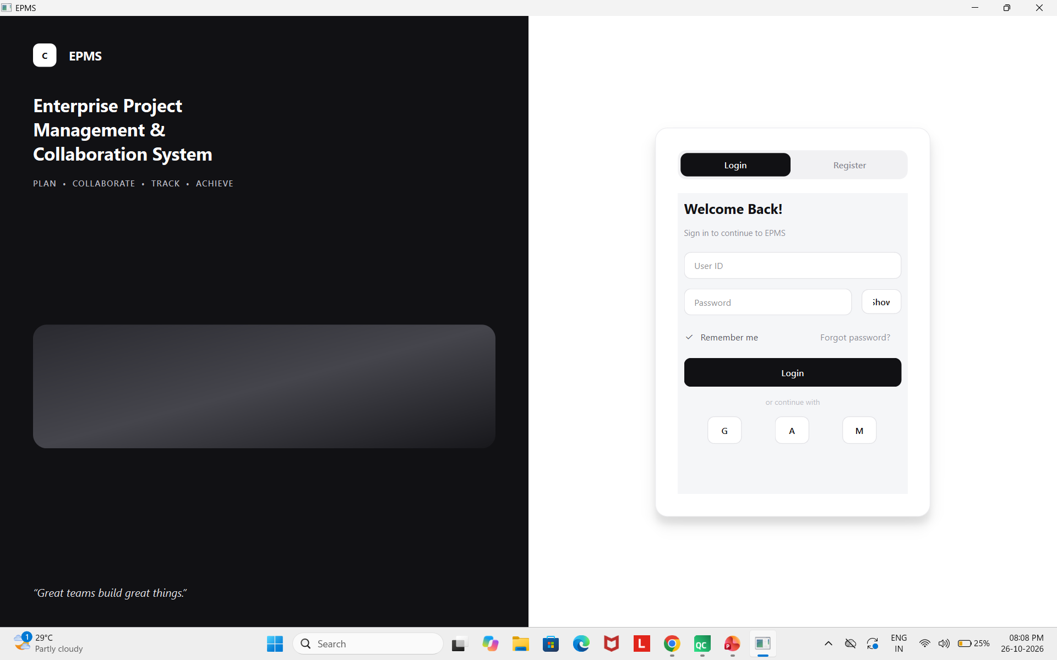
Sample Output

Slide 12

Advantages
Streamlines project activities by reducing manual effort, improving workflow efficiency, and helping teams complete tasks within the planned timeline.
Enhances communication and collaboration among team members by providing centralized project information, task updates, and shared progress reports.
Enables real-time monitoring of project progress by tracking task completion, upcoming deadlines, pending activities, and overall project performance.
Supports effective decision-making through analytical reports and performance insights, helping managers identify delays, optimize resources, and improve project outcomes.

Slide 13
Conclusion
EPMS provides a centralized platform for managing project tasks, schedules, deadlines, and team activities, making project planning and execution more organized and efficient.
Enhances communication and collaboration among team members by providing shared project information, task updates, and clear visibility into individual responsibilities.
Enables continuous project progress monitoring through performance dashboards, analytical charts, and reports that help identify delays, pending tasks, and areas requiring improvement.
Supports better decision-making and resource management by providing useful project insights, helping managers resolve issues early, improve productivity, and achieve successful project completion within the planned timeline.

